Slide 1
TESTING

Slide 2
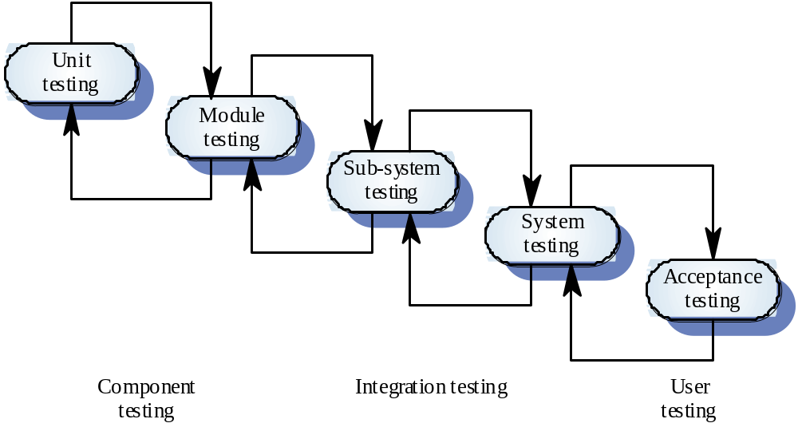
The testing process

Slide 3
STAGES IN THE TESTING PROCESS
Unit Test – individual components
Module Test – module = collection of components such as an object class or loose collection of functions
Sub-System Test – collection of integrated modules. Look for interface mismatch.
System Test – integrated subsystems. Find errors from unanticipated interactions
Acceptance Test – test with “real” data. Find errors and omissions in requirements

Slide 4
TEST PLANNING
Sets standards for testing process rather than describing product tests
Expensive
Begins when system requirements are formulated and should be developed in detail as software is designed.

Slide 5
THE TEST PLAN
The testing process
Requirements traceability
Tested items
Testing schedule
Test recording procedures
Hardware and software requirements
Constraints

Slide 6
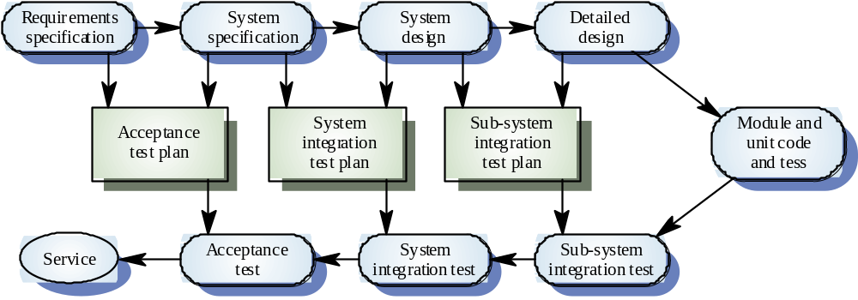
The V-model of development

Slide 7
UNIT TESTING
Usually the responsibility of the programmer
Black box testing
  Specification based
White box testing
  Program based
Normally perform both

Slide 8
BLACK BOX TESTING
Tests module against functional and non-functional specifications
Specification used to derive test cases
Do not look at module code (except to debug)
Attempt to force behavior that doesn't match specification
Problem – how to select inputs that have a high probability of causing error
  Experience, domain knowledge

Slide 9
APPROACHES TO
BLACKBOX TESTING
Equivalence partitioning
Boundary value analysis
Stress testing

Slide 10
EQUIVALENCE PARTITIONING
Equivalence class is related set of valid or invalid values or states
Divide input domain into equivalence classes
Attempt to cover classes of errors
One test case per equivalence class, to reduce total number of test cases needed

Slide 11
RANGE EQUIVALENCE CLASSES
Assumes scalar
Arbitrary value below range
Arbitrary value within range
Arbitrary value above range

Slide 12
EXAMPLE
Program specification states that the system will accept between 4 and 10 inputs which are 5-digit integers. Partition system inputs and outputs into ‘equivalence sets’
  If input is a 5-digit integer between 10000 and 99999, equivalence partitions are
  <10000, 10000-99999 and >10000
Choose test cases at the boundary of these
sets
  00000, 09999, 10000, 99999, 10001

Slide 13
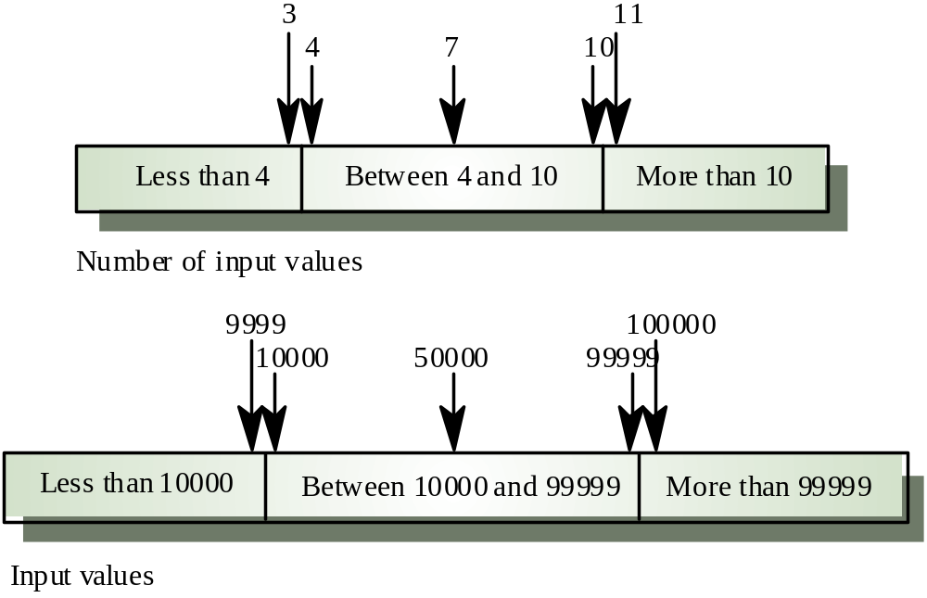
Equivalence partitions

Slide 14
SET EQUIVALENCE CLASSES
Member of set
Non-member of set

Slide 15
BOUNDARY VALUE ANALYSIS
Complements equivalence partitioning (typically combined)
In practice, more errors found at boundaries of equivalence classes than within the classes
Divide input domain into equivalence classes
Also divide output domain into equivalence classes
Need to determine inputs to cover each output equivalence class
Again one test case per equivalence class

Slide 16
RANGE EQUIVALENCE CLASSES
Value immediately below range
First value of range
Second value of range
Next to last value of range
Last value of range
Value immediately above range
Minimum and maximum values of range's basic type (optional)

Slide 17
SCALAR SET EQUIVALENCE CLASSES
Member of set
Values immediately above and below each member of set
Minimum and maximum values of set element's basic type (optional)

Slide 18
NON-SCALAR SET EQUIVALENCE CLASSES
Member of set
Null value (if not in set)
Other non-member value(s) of correct type ("above" and "below" each set member, "minimum" and "maximum" of type, if such concepts are applicable)
Value of incorrect type, structurally equivalent (if not detected by compiler)
Value of incorrect type, not structurally equivalent (if not detected by compiler)

Slide 19
STRESS TESTING
Large amounts of data
Worst case operating conditions
Combinations of events

Slide 20
WHITE BOX TESTING
Complementary to black-box
Tester can analyze the code and use knowledge about the structure to derive test cases
Knowledge of the algorithm can be used to identify equivalence classes
Tests control and/or data flow paths through module

Slide 21
ADEQUACY CRITERIA
Execute all (reachable) statements
Execute all branches of logical decisions, including boundaries of loops
Execute all (feasible) control flow paths in combination
Execute all data flow paths (from each definition to all its uses)
Usually applied only to individual subroutines rather than module as a whole
May be combined with black box testing if tool available to track code coverage

Slide 22
STATEMENT COVERAGE
Requires each statement in program be executed at least once
85% easy, 100% hard
  Unreachable code
  Dead code
  Complex sequence
Microsoft reports 80-90% code coverage

Slide 23
PATH TESTING
A strategy whose objective is to exercise every independent executable path
Starting point is the program flow graph
Flow graph constructed by replacing program control statements with diagrams
Used as a basis for computing the cyclomatic
complexity
Complexity = Number of edges - Number of
nodes +1

Slide 24
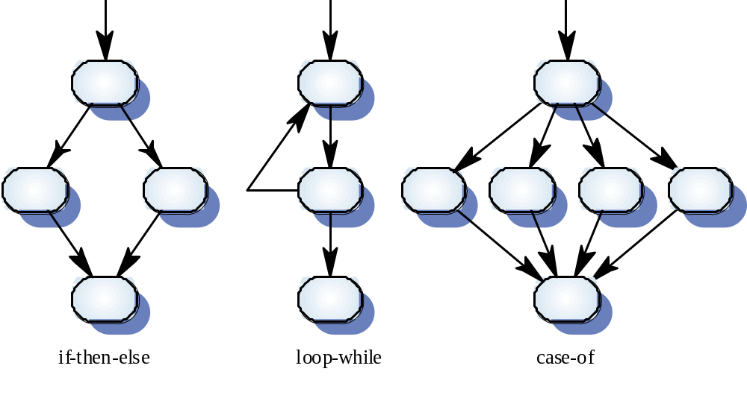
Flow graph representations

Slide 25
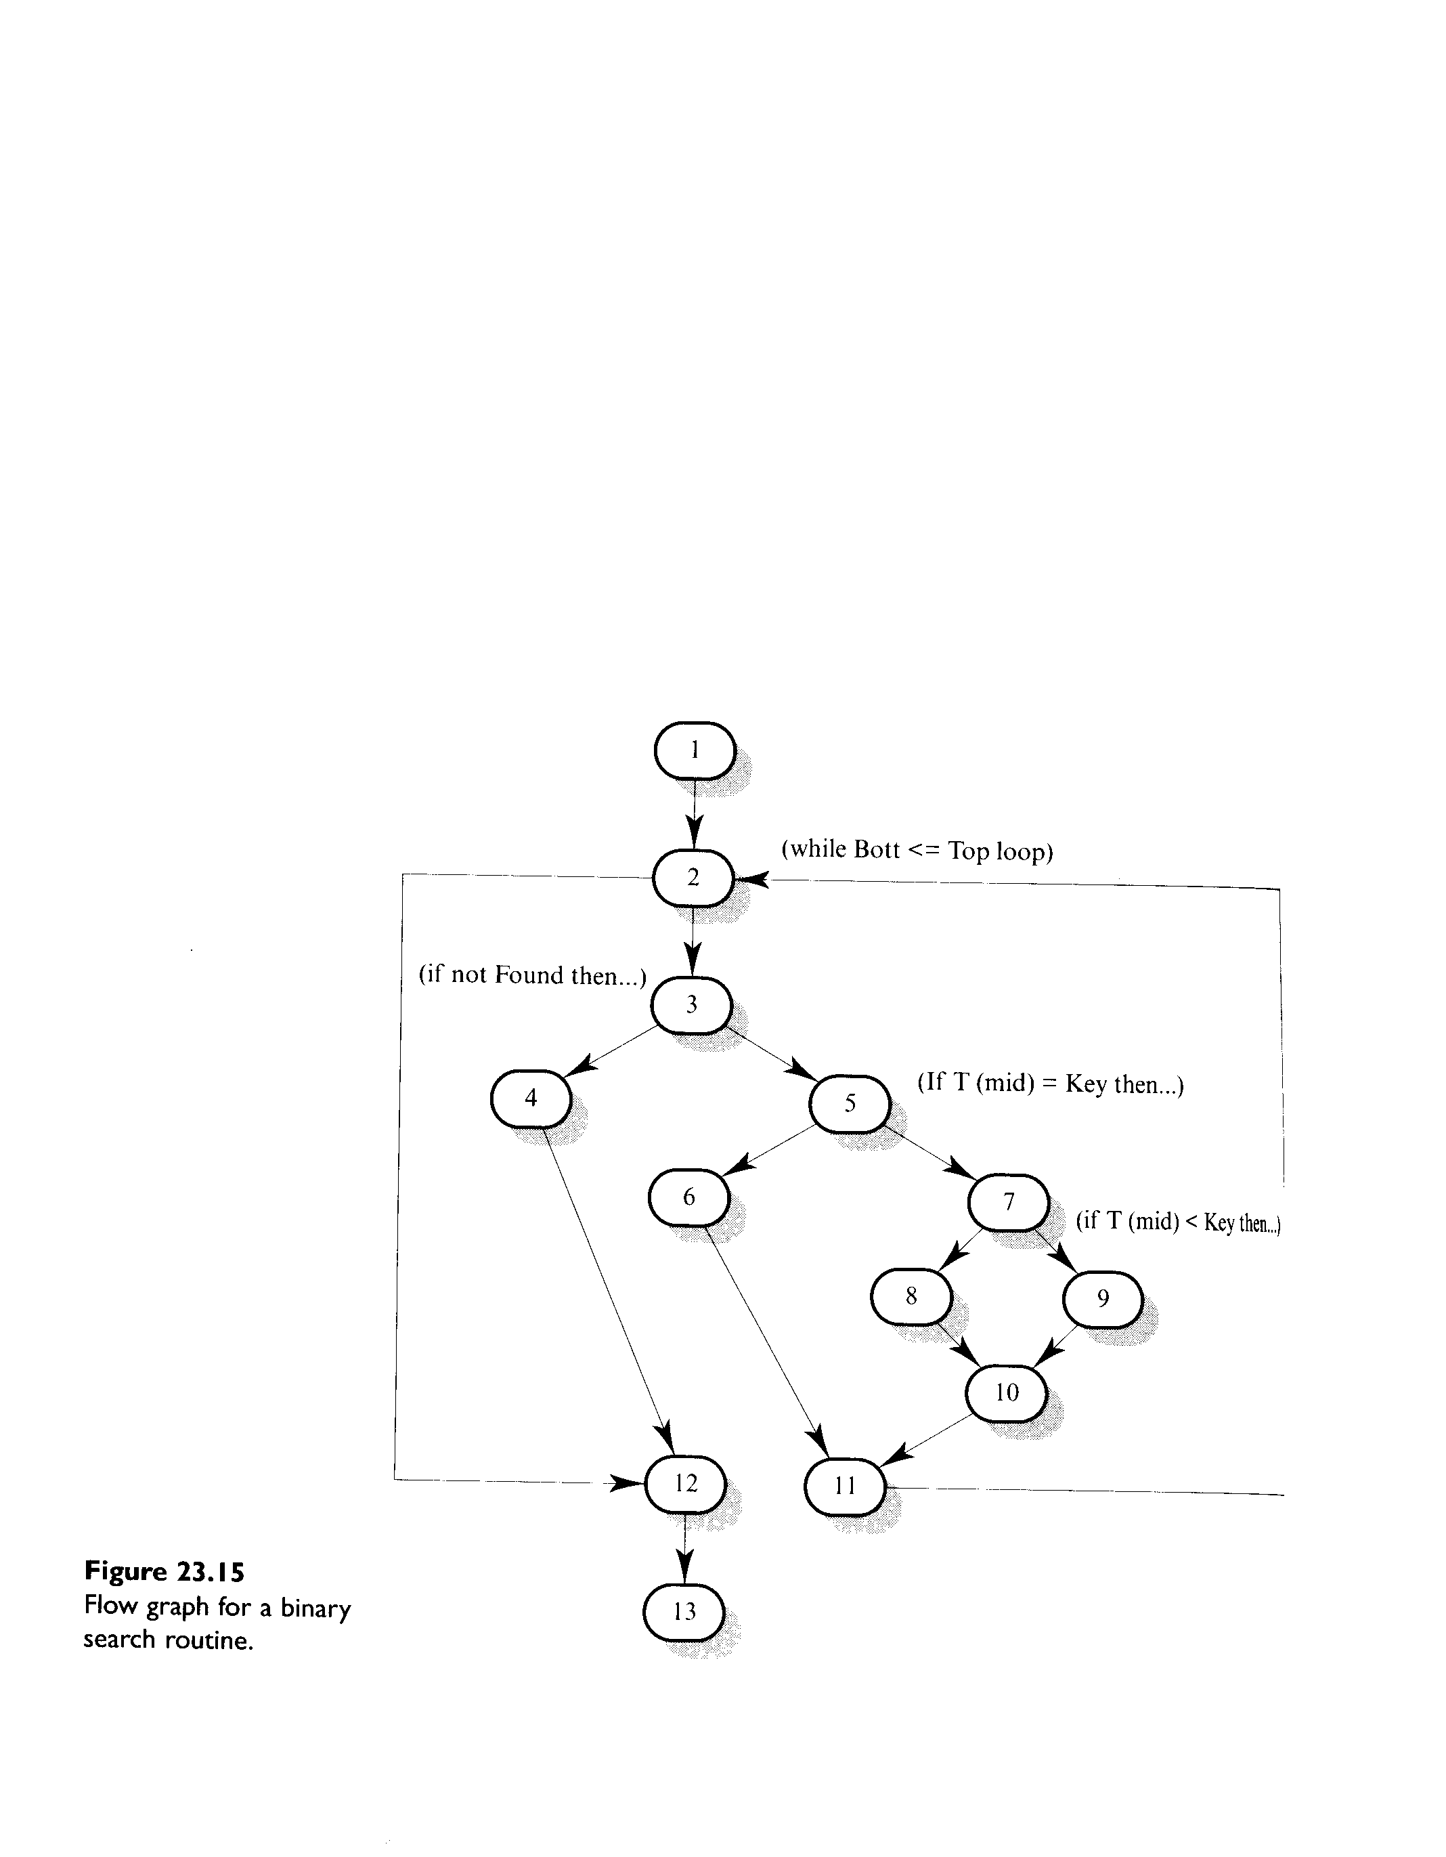

Slide 26
BINARY SEARCH PATHS
1, 2, 3, 4, 12, 13
1, 2,3, 5, 6, 11, 2, 12, 13
1, 2, 3, 5, 7, 8, 10, 11, 2, 12, 13
1, 2, 3, 5, 7, 9, 10, 11, 2, 12, 13
Test cases should be derived so that all of these paths are executed
A dynamic program analyser may be used to check that paths have been executed

Slide 27
TEST CASES
After determining the independent paths, design test cases for each path
The minimum number of test cases is equal to the cyclomatic complexity.
Problem – path testing cannot test all possible combinations of paths through a program. There are an infinite number of possible path combinations in programs with loops

Slide 28
EXERCISE
A safety-critical system fails and several lives are lost. When the cause of the failure is investigated, the inquiry commission determines that the test plan neglected to consider the case that caused the system failure. Who is responsible for the deaths:
The testers for not noticing the missing case? The test planners for not writing a complete test plan? The managers for not having checked the test plan? The customer for not having done a thorough acceptance test?

Slide 29
EXERCISE
Sometimes customers hire an independent organization to do independent verification & validation. The V & V staff examines all aspects of development, including process and product to ensure the quality of the final product. If an independent V &V team is used and the stysem still experiences a catastrophic failure, who should be held responsible?
the managers, the V &V team, the designers
the coders or the testers

